Slide 1

APPRENTICESHIP REVIEW
Year 3 Progress, Carpenter
Registration NC-APP-2023-4417, review dated February 20, 2026
Apprentice Jordan Thomas McDaniel | Sponsor Ridgeline Builders LLC

Slide 2
SNAPSHOT
Where Things Stand
Year
OJT hours
Instruction
On track
3 of 4
5,210 / 8,000
388 / 576
April 2027
Year three has meant more solo finish work, a clean trim and cabinet record on a Wake Forest kitchen, and steady support on a deck build in Apex. The hours are on pace. The next formal review opens Year 4.
Year 3 apprenticeship review
Confidential

Slide 3
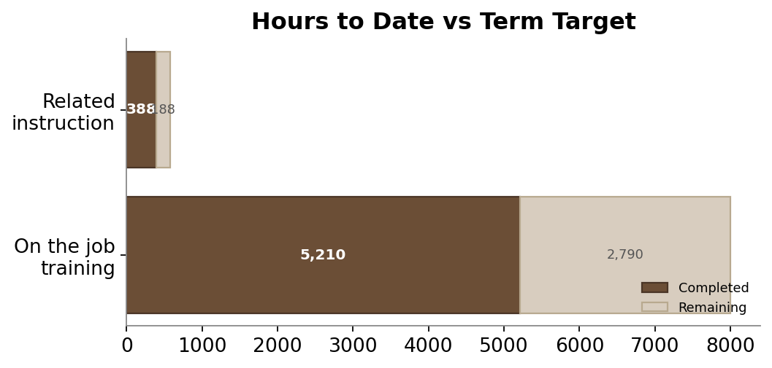
HOURS
Training Hours to Date
Measure | Done | Target
On the job training | 5,210 | 8,000
Related instruction | 388 | 576
Remaining OJT | 2,790
Remaining RTI | 188
Year 3 apprenticeship review
Confidential

Slide 4
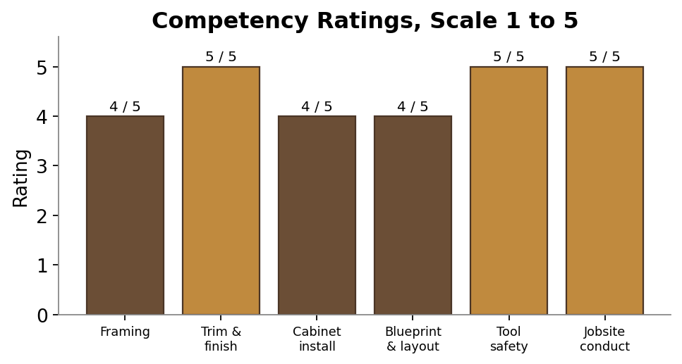
SKILLS
Competency Ratings
• Trim and finish: strongest area, rated 5
• Tool safety and jobsite conduct: rated 5
• Framing, cabinet install, layout: solid 4s
• Build speed and self quoting come with hours
Year 3 apprenticeship review
Confidential

Slide 5
NEXT
Path to Journeyman
Milestone | When | Status
Reach 8,000 OJT hours | By April 2027 | On pace
Complete 576 instruction hours | By April 2027 | On pace
Final competency review | Start of Year 4 | Scheduled
Journeyman certification | 2027 | Pending hours
Supervisor note: works clean, asks the right questions, trusted with solo finish work. No attendance or conduct concerns on file.
Year 3 apprenticeship review
Confidential

